Slide 1
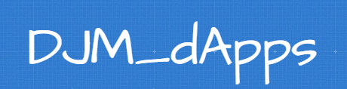
by
Dave - Joe - Miguel
https://shawry6.github.io/DJM_dApps

Slide 2
Motivation & Summary
DJM_dApps
Smart Contracts transacting on the Ethereum Blockchain
This is a governance process which enables any group of people to agree on anything imaginable. This is achieved through the following steps:
Proposal of Ideas submitted on the blockchain
Voting for Proposals by the group members
Bidding on a Winning Proposal by Suppliers
Contracting the Winning Bidder to fulfill the Winning Proposal by the Chairperson/s of the group.

Slide 3
Technologies
Written in the Solidity programming language
HTML and Javascript for UIs
hvPlot for statistics

Slide 4

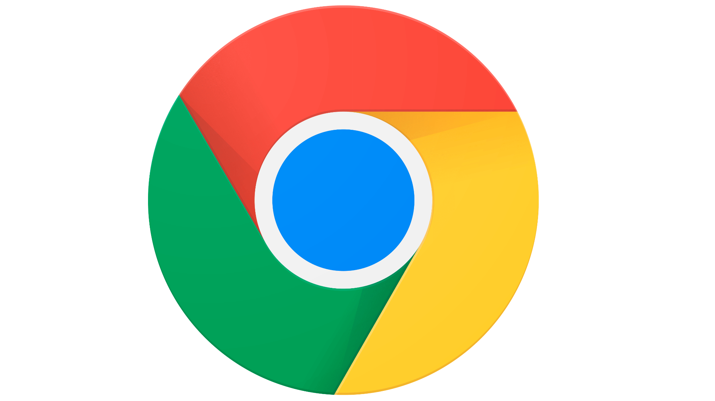
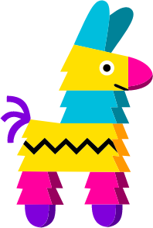
Installation Guide
To transact with DJM_dApps you’ll need:
A digital wallet with Ethereum to transact. We recommend Metamask.
Compatible browser. We recommend Google Chrome.
Pinata to view blockchain submissions
For the geeks:
To compile and deploy DJM_dApps we used and tested with Remix, Ganache and Metamask

Slide 5
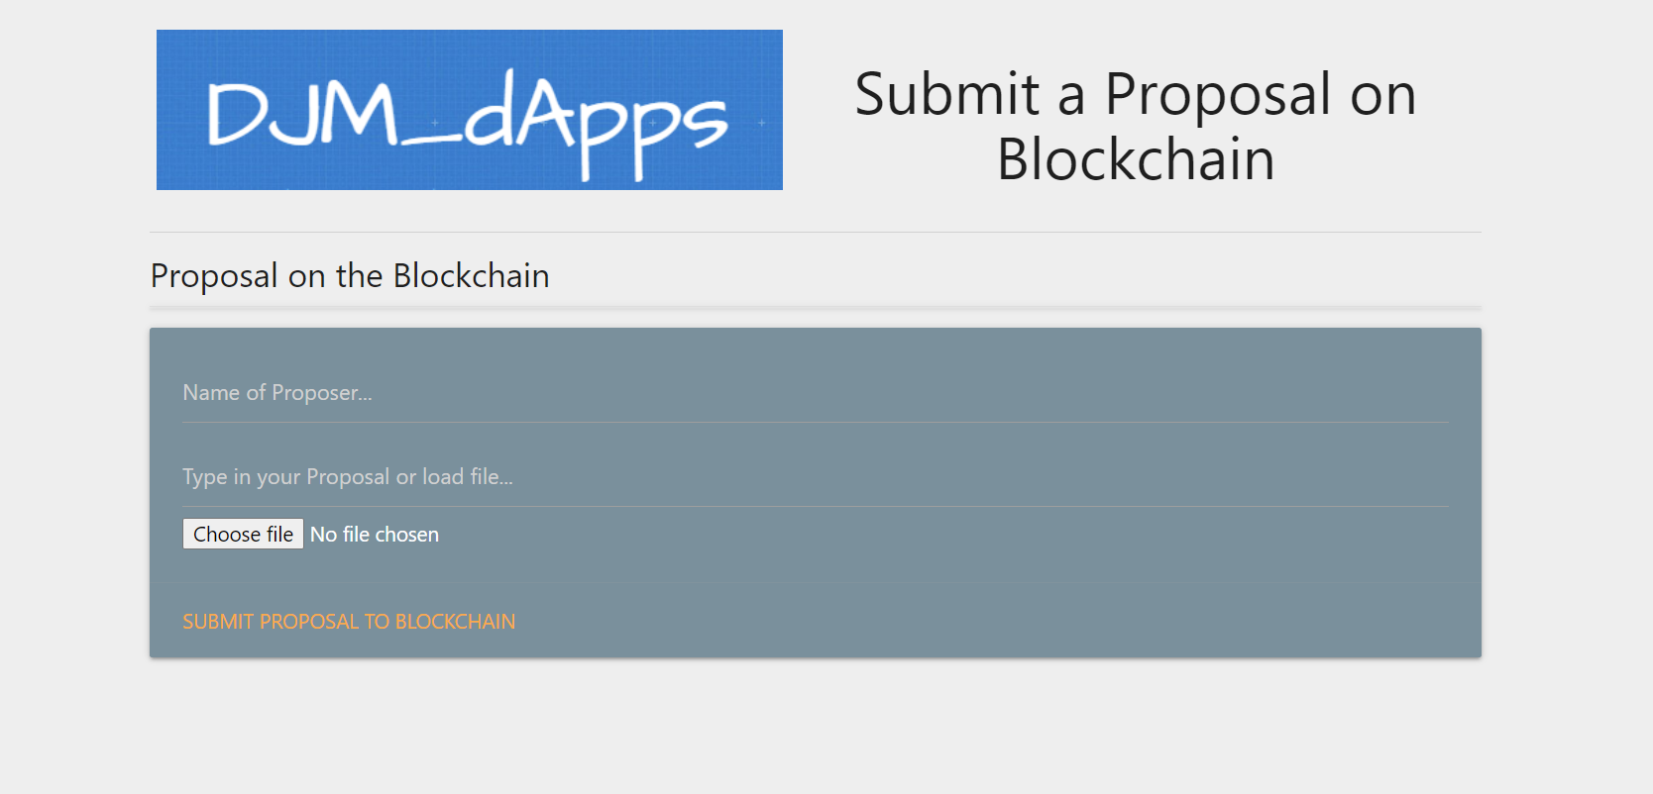
Joe’s presentation of the Proposal dApp

Slide 6
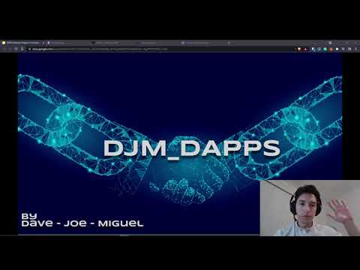
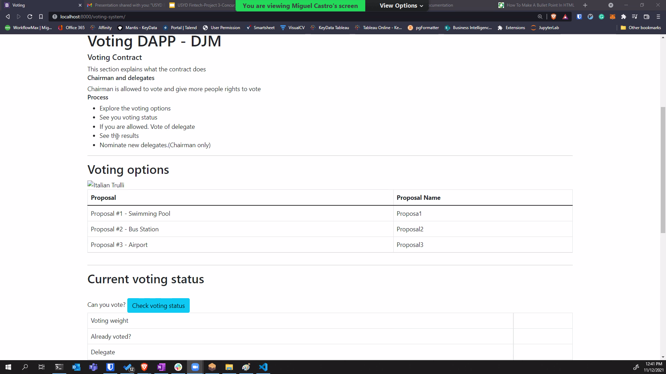
Miguel’s presentation of the Voting dApp

Slide 7
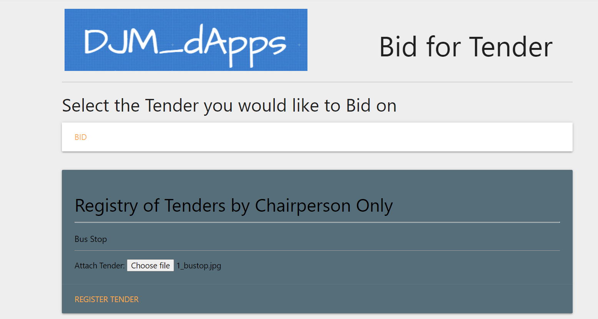
Dave’s presentation of the Voting dApp

Slide 8
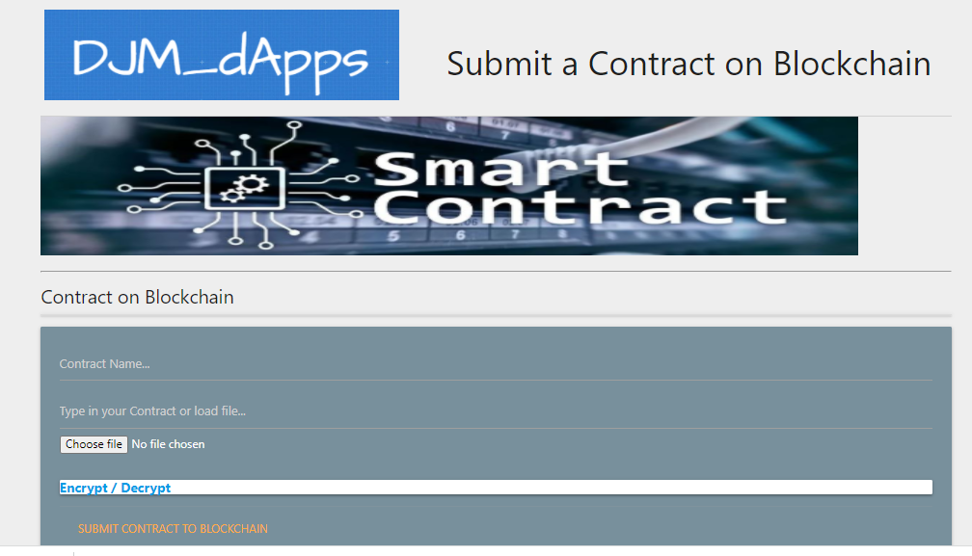
Joe’s presentation of the Contract dApp

Slide 9
Issues / Improvements
The User GUI involves a whole new world of coding which we had to quickly adapt to. There are many aspects that can be improved here with better knowledge of UI/UXs.
The efficiency of transactions needs to be improved. The process of coding within solidity, testing and transacting with Ganache and Metamask with UIs in Javascript and html then pushing submissions to the IPFS via Pinata.

Slide 10
Useful Resources
Ethers.js
https://docs.ethers.io/v5/
Plotly
https://plotly.com/javascript/getting-started/#start-plotting
YouTube
www.youtube.com
Remix
www.remix.ethereum.org
OpenZepplin
https://openzeppelin.com/

Slide 11

Questions

